Slide 1
Game Algorithms
GAM 1574
Dan Lingman
lingmad@algonquincollege.com
https://www.facebook.com/Dan.Lingman
https://www.linkedin.com/pub/dan-lingman/1/51a/300
https://twitter.com/Lingman
dlingman@gmail.com

Slide 2
Flocking Fundamentals
It all starts with a Boid…
Forces
Velocity
Turn Rate
Line of Sight

Slide 3
Flocking Fundamentals
Three basic motivations driving a Boid
Avoidance - keep your distance from other Boids and Obstacles
Coherence - try to move towards the middle of the flock
Alignment - head in the same general direction as the rest of the flock

Slide 4
Flocking Fundamentals
Hands on
Build a player controlled Boid that moves in three dimensions

Slide 5
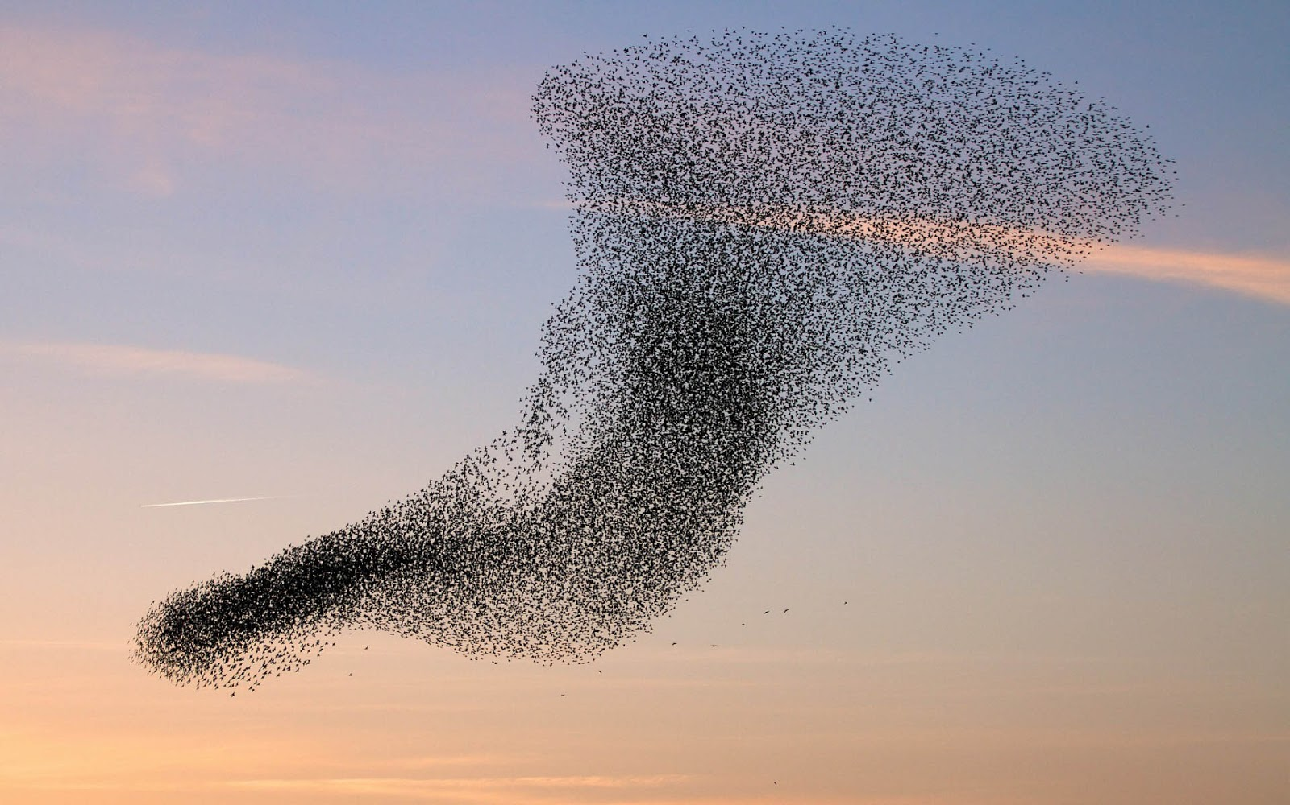
Flocking Fundamentals
So what is a flock? When you think of a flock, you're probably immediately thinking of something like this:
source: https://www.howitworksdaily.com/wp-content/uploads/2015/07/wallpaper-of-a-flock-of-flying-birds-hd-bird-wallpapers.jpg

Slide 6
Flocking Fundamentals
And you'd be right. Each of the birds in that flock are operating independently, without cohesive control, yet the flock remains together, appearing like a single unified (albeit fluid) entity.
The previous movement code we've had worked by manually setting the location and rotation of the vehicle being moved. That's not quite how Boids will work.

Slide 7
Flocking Fundamentals - Boid?
Traditionally, in flocking simulations, the thing that is making up the flock is called a Boid.
Sort of a hybrid between a Bird and an Android.
This was chosen because they have nowhere near the depth of real birds, but need to act in a recognizable pattern like birds.

Slide 8
Flocking Fundamentals - Forces
Forces are what actually move things in the real world. But is our Boid simulation is going to use them as well?
Applying a force from directly behind us will tend to shift us forward. Applying a force of the same magnitude, but at an angle, will both move us forward, and change our heading.

Slide 9
Flocking Fundamentals - Forces
If we apply multiple forces, these can be added as vectors to give us a net force. Sometimes doing so results in some of the forces canceling out.
Acceleration = force/mass
Acceleration acts to alter velocity. Remember that velocity is also a vector, so it has both direction and magnitude.

Slide 10
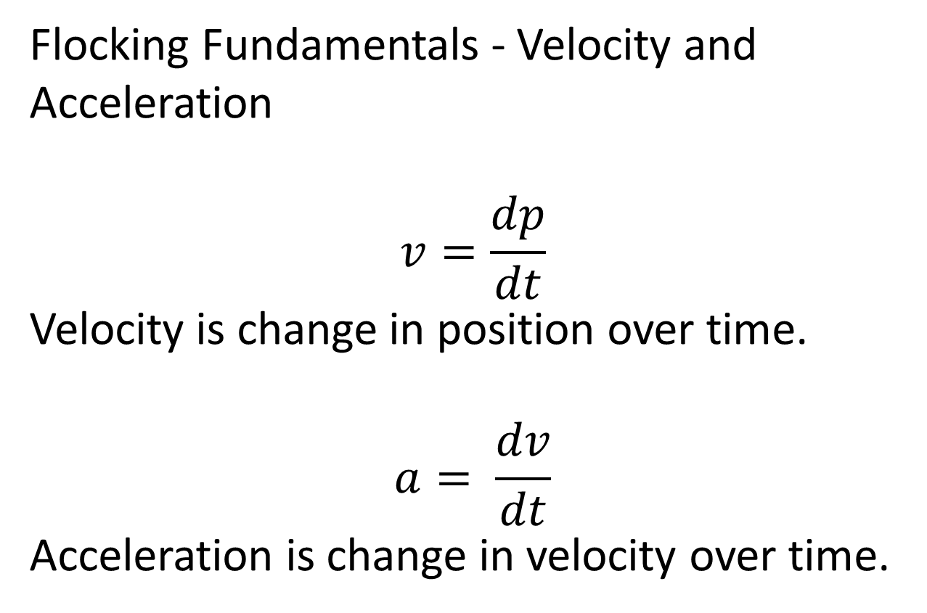
Flocking Fundamentals - Velocity and Acceleration
$$v=\frac{dp}{dt}$$
Velocity is change in position over time.
$$a= \frac{dv}{dt}$$
Acceleration is change in velocity over time.

Slide 11
Flocking Fundamentals - Forces
When we're computing the vectors that are eventually going to drive our Boid, we want to make sure that we're not overdriving it.
The Boid will have a top speed, and a maximum turn rate. We need to ensure that our acceleration we're trying to apply does not wind up exceeding those.

Slide 12
Flocking Fundamentals - Forces
We set our Boid up so that it is facing in the Z direction. If this is done, then Unity gives us a number of helpful values on the transform property of the game object.
Rotating game objects will result in also rotating the 3 major axes of the object.
(Yes, axes is the correct plural of axis.)

Slide 13
Flocking Fundamentals - Forces
transform.forward - unit vector towards the blue axis.
transform.up - unit vector towards the green axis.
transform.right - unit vector towards the red axis.

Slide 14
Flocking Fundamentals - Forces
How can we manipulate these in our update (or late update) methods?
float speed = 10.0f;
void Update()
{
if (Input.GetKey(KeyCode.UpArrow))
{
transform.position += transform.forward*speed;
}

Slide 15
Flocking Fundamentals - Forces
Continuing…
if (Input.GetKey(KeyCode.LeftArrow))
{
transform.Rotate(transform.up,speed,Space.World); }

Slide 16
Flocking Fundamentals - Forces
One critical thing to note with that code, is that it’s NOT going to run the same for everyone. In it, you’re moving a specific direction, or turning by a certain amount, per frame, not per second. You want to multiply the speed by Time.deltaTime to use the actual time that passed since the last frame. Doing this, means that speed is now units per second.

Slide 17
Flocking Fundamentals - Line of sight
When determining what other Boids in our flock are going to influence us, we have several choices.
We can use a full sphere look around - i.e., if it's within a certain distance, we can see it.
Alternatively, we can look forward in a cone, using standard field of view logic to see where it is.

Slide 18
Flocking Fundamentals - Line of sight
Vector3.Angle is your friend for this.
Open up the angle test unity project to see this in operation.
Please note that this gives the UNSIGNED angle between two vectors. There is a SignedAngle function you can use if you need to know the direction from A to B around a given axis as well.

Slide 19
Flocking Fundamentals - Motivation
There are three primary motivations that a Boid has. Combined, these simple rules display emergent behavior that looks remarkably like flocks of birds or schools of fish. They are:
Avoidance
Cohesion
Alignment

Slide 20
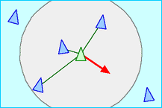
Flocking Fundamentals - Avoidance
Quite simply, don't run into other Boids.
This is done by steering away from local flockmates.
Source: http://www.red3d.com/cwr/boids/

Slide 21
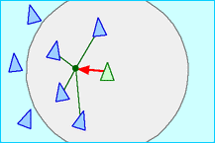
Flocking Fundamentals - Cohesion
Steer towards the average position of local flockmates.
Source: http://www.red3d.com/cwr/boids/

Slide 22
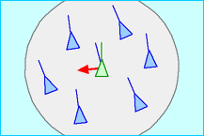
Flocking Fundamentals - Alignment
Turn towards the average heading of local flockmates.
Source: http://www.red3d.com/cwr/boids/

Slide 23
Flocking Fundamentals - Motivation
Avoidance and Cohesion seem to be at odds with each other. They're not.
And what exactly is are local flockmates?
There are two ways to view this.
The first is purely by distance.
The second also uses field of view.

Slide 24
Flocking Fundamentals - Motivation
Distance based is like the picture seen earlier. Everything in the circle is counted.
Everything outside of the circle is ignored as being too far away to influence the boid.
Some flocking sims use the distance as a weighting factor as well.

Slide 25
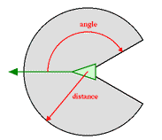
Flocking Fundamentals - Motivation
A more sophisticated method uses field fo view. Anything outside of that is considered to be out of the peripheral vision, and ignored. Distance is still also used as a filter.

Slide 26
Flocking Fundamentals - Motivation
Avoidance is computed by adding the direction vectors from the nearby neighbors towards the Boid in question.
in pseudo code:
avoidance = vector3.zero
for each neighbor
avoidance += boid pos - neighbor pos
normalize the avoidance vector

Slide 27
Flocking Fundamentals - Motivation
Cohesion is taken by adding the positions, then dividing by the number of neighbors. Find the direction to that point.
center = vector3.zero
count = 0
for each neighbor
center += neighbor pos
count++
center /= count
cohesion = center - boid.pos
normalize cohesion

Slide 28
Flocking Fundamentals - Motivation
Alignment is found by adding the direction vectors for all neighbors, then normalizing it.
alignment = vector3.zero
for each neighbor
alignment += neighbor rotation
normalize alignment

Slide 29
Flocking Fundamentals - Motivation
The three vectors are then added, possibly with weights for each, then normalized to get the direction that the Boid wants to turn towards to reach it’s goals.
Once we know where we are going, we can use quaternion slerping (interpolation) to rotate, clamping that rotation to our maximum turn rate.

Slide 30
Flocking Fundamentals - Motivation
Once rotated, we can move the Boid forward, based on it's speed and the elapsed time.
We'll save the implementation of that for next week though.

Slide 31
Flocking Fundamentals - Hands on
For this week, we're going to get a single Boid that is actually a player-controlled spy plane.
You'll need something to move around. Ideally something that you know is moving in a particular direction.
How you get this thing is up to you.

Slide 32
Flocking Fundamentals - Hands on
If you want to do something simple, create a box and a couple of spheres. scale and position them so the spheres are 1/2 inside the box on one side. Make sure that they are in the Z direction, as that is forward for our purposes. (That's the blue direction vector off an object if you've forgotten.)
Fancier is to drop in something you have already modeled in 3dsMax or blender.

Slide 33
Flocking Fundamentals - Hands on
Add a script to check for the arrow keys (as per the code snippets earlier). If pressed rotate around the appropriate axis.
You'll also need to move. One simple way for that to work is to add a scaled transform.forward vector to the position each update.
If you do, make sure you're moving slowly enough that you are controllable.

Slide 34
Flocking Fundamentals - Hands on
Finally, attach the camera to the player-controlled object. Once you've added it, zero out the rotation and position transform bits, and then shift and rotate it manually so it is behind, and slightly above the player object, and looking a bit down towards it.
You should now be able to fly around your scene. Add a few spheres etc. so you have something to see as you try flying.

